Slide 1
Defending the Hudson Highlands in the Revolutionary War
Putnam History Museum

Slide 2
Do Now:
Hudson River
Use this map to answer the questions below.
1. Draw a straight line from Pennsylvania to Massachusetts, what states do you cross through?
2. Now draw a straight line from Virginia to Connecticut, what states do you cross through?
3. Finally, draw a straight line from South Carolina to New Hampshire, what states do you cross through?

Slide 3
The Strategic Importance of New York
Hudson River
Land routes between the Southern and Northern states crossed through New York State. This meant that if Britain controlled New York State, the Americans wouldn’t be able move soldiers or supplies from the south to the north.
Today we will learn how the Hudson Highlands played a key role in defending New York State against the British.

Slide 4
New York at the Beginning of the Revolution
The American Revolution began in 1775 with battles in Massachusetts. By 1776 fighting moved to New York.
The Americans lost the Battle of Long Island, the Battle of White Plains in Westchester County, and the Battle of Fort Washington in New York City.
The British took control of New York City in September of 1776.

Slide 5
The Hudson River and Hudson Highlands
Hudson Highlands
The Hudson River ends in New York City where it connects to the Atlantic Ocean.
The Hudson Highlands are mountains on both sides Hudson River located north of New York City.
The Hudson River becomes narrow and curved in the Hudson Highlands.
Start of the Hudson River

Slide 6
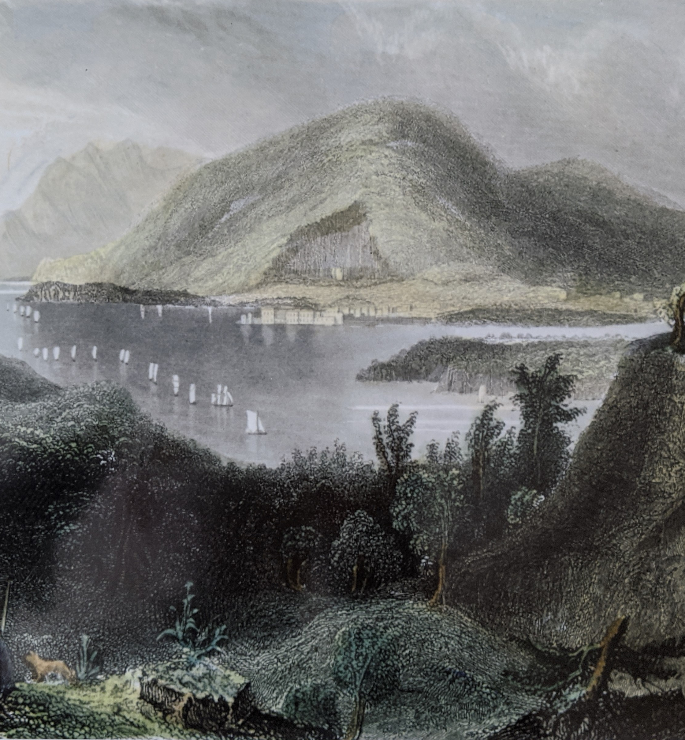
Strategic Importance of the Hudson Highlands
The Americans controlled the Hudson Highlands. This allowed the army to move food, supplies, and soldiers through New York State to the Upper, Middle, and Lower states.
Controlling the Hudson Highlands prevented the British from sailing up the Hudson River and capturing the rest of the New York State.
If the Americans lost the Hudson Highlands, the United States would be divided in two.

Slide 7
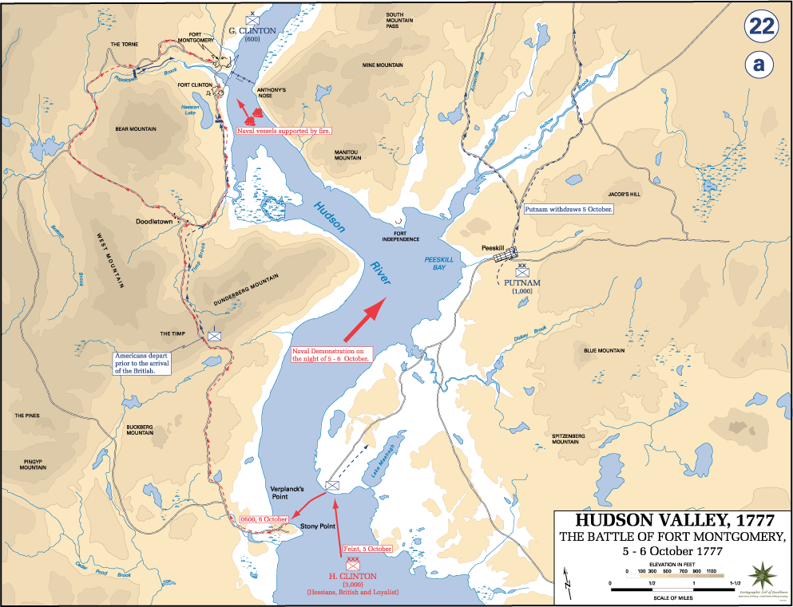
Battles in the Highlands
In October 1777, a British army sailed up the Hudson River from New York City and captured two American forts in the Hudson Highlands called Fort Clinton and Fort Montgomery.
Beverly Robinson, a Loyalist from what is now Garrison, NY, helped lead the British attack.
A Loyalist was an American colonist who stayed loyal to the British.

Slide 8
Battles in the Highlands
The British destroyed the Forts and a chain that the Americans placed across the Hudson River to keep British ships from sailing further upriver.
This attack left the Hudson Highlands and Hudson River poorly defended.

Slide 9
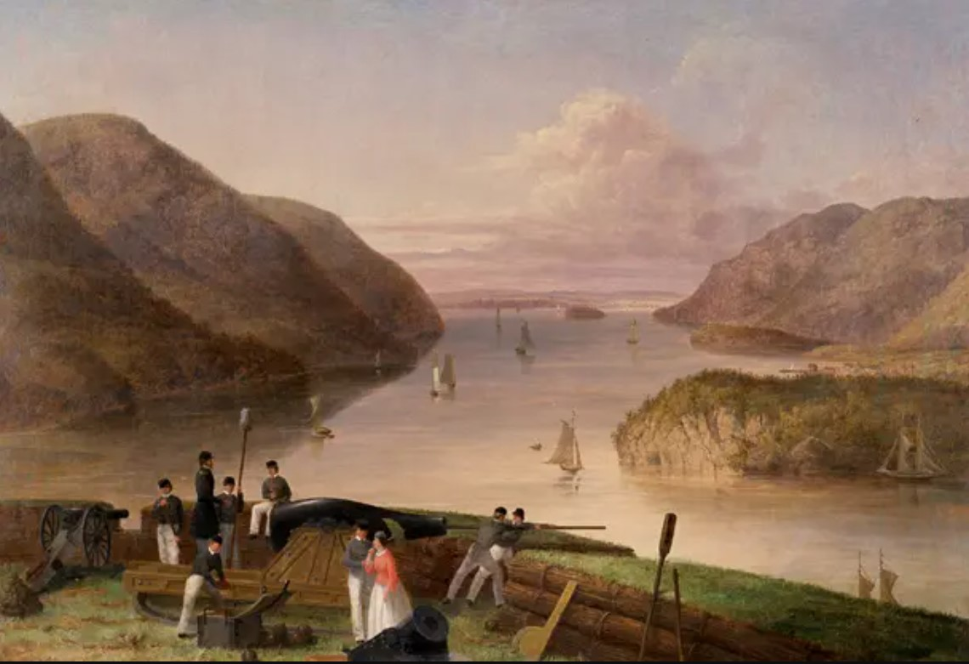
Fortress West Point
After this battle, General George Washington ordered the construction of Fortress West Point on the west shore of the Hudson River across from present day Garrison, NY.
This area was chosen because the Hudson River’s narrow width and sharp turns at West Point made it hard for large ships to sail through.

Slide 10
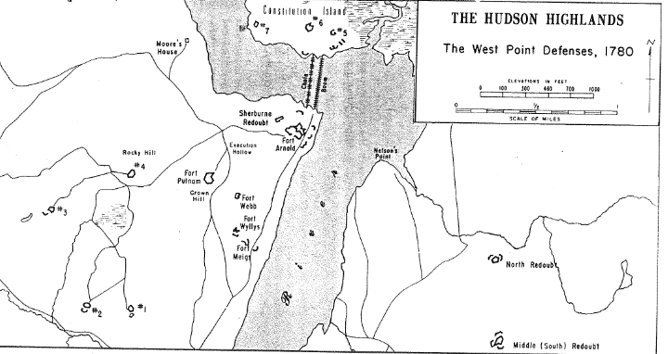
Fortress West Point
Fortress West Point was designed by military engineer Tadeusz Kosciuszko
It was not a single building. West Point included multiple forts near the river, defensive lookouts called redoubts, and a new iron chain across the river to block British ships.
This design created circles of defense around West Point.

Slide 11
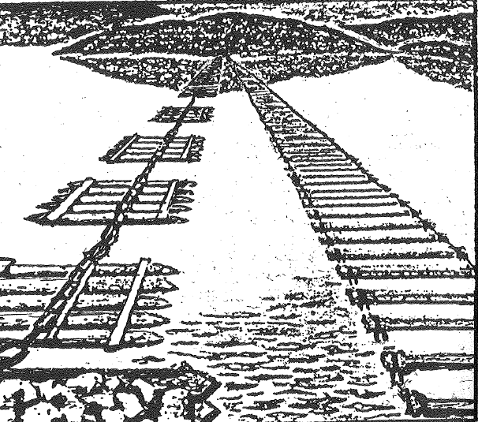
The Great Chain
In the spring of 1778, an iron link chain the length of six football fields was stretched across the Hudson from West Point to Constitution Island. It was upriver from the chain destroyed at Fort Montgomery.
The chain rested on wooden rafts to help it float on the river. It was built by army engineer Thomas Machin and called “The Great Chain”
A chain of logs was stretched across the river behind the chain as a second line of defense.

Slide 12
The Great Chain
In the 1700s, the Hudson River froze during the winter. From 1778 until the end of the war in 1783, soldiers removed the Great Chain each fall and stretched it across the river in the spring.
British ships never tried to attack the Great Chain.

Slide 13
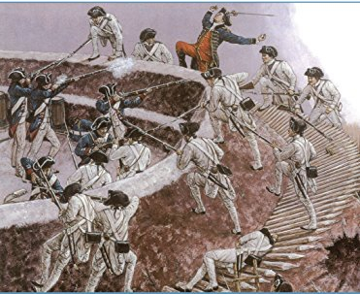
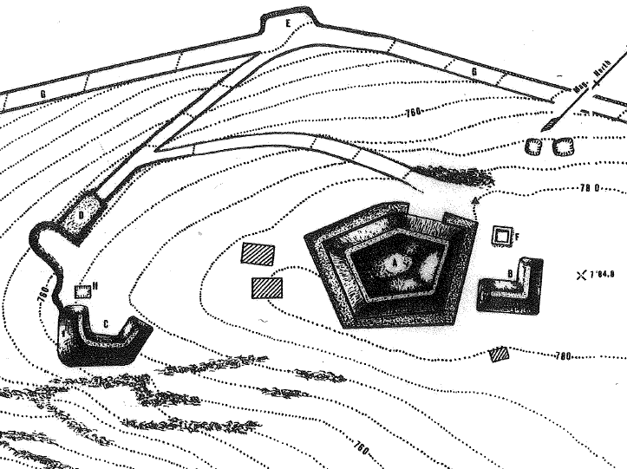
Redoubts
The Great Chain blocked the river, but the chain and West Point’s forts could still be attacked by land.
To prevent these attacks, Tadeusz Kosciuszko built redoubts in the mountains surrounding the river. A redoubt is an enclosed, temporary defensive position used to protect an important point such as a hill. It is made of earth and stone.

Slide 14
Redoubts
Two of West Point’s redoubts, called the North and South Redoubt, were in present day Garrison, NY.
They were manned by Continental Army soldiers who stood watch over the river and guarded against British attacks by land
The soldiers slept in huts near the redoubts

Slide 15
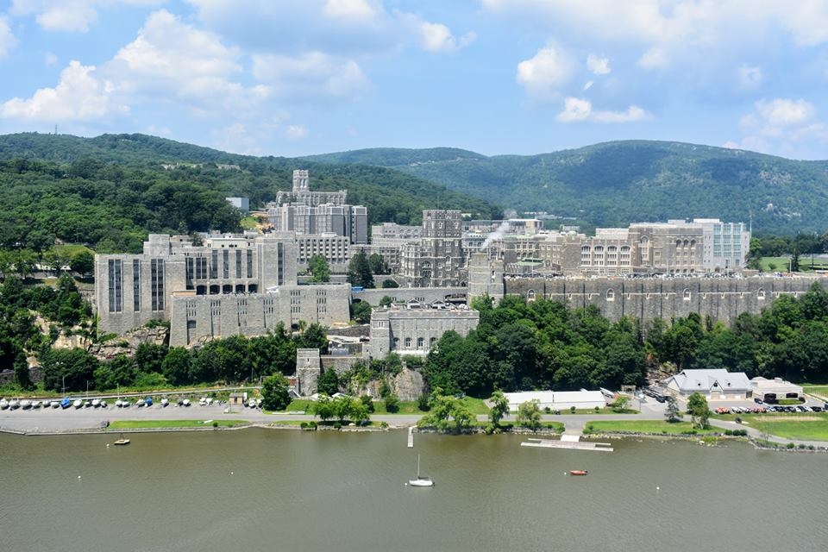
Conclusion
Fortress West Point helped the Americans keep control of the Hudson Highlands and ensured supplies, food, and soldiers could travel from the Northern States to the Southern States through New York.
West Point was never captured by the British. It is still standing today. It is the site of the United States Military Academy.

