Slide 1
The Industrial Revolution and its Effects
Putnam History Museum

Slide 2
What was the Industrial Revolution?
The Industrial Revolution replaced human labor with machines. The US workforce shifted from agriculture to manufacturing.
Production was moved from a domestic system of individuals working from home, to a factory system that brought many workers and machines together in one place.
Machine manufacturing led to higher levels of production.
The process changed Americans daily lives, created new products, and altered the country’s landscape.
The West Point Foundry was opened in 1817, making it one of the first large industrial enterprises in the United States.

Slide 3
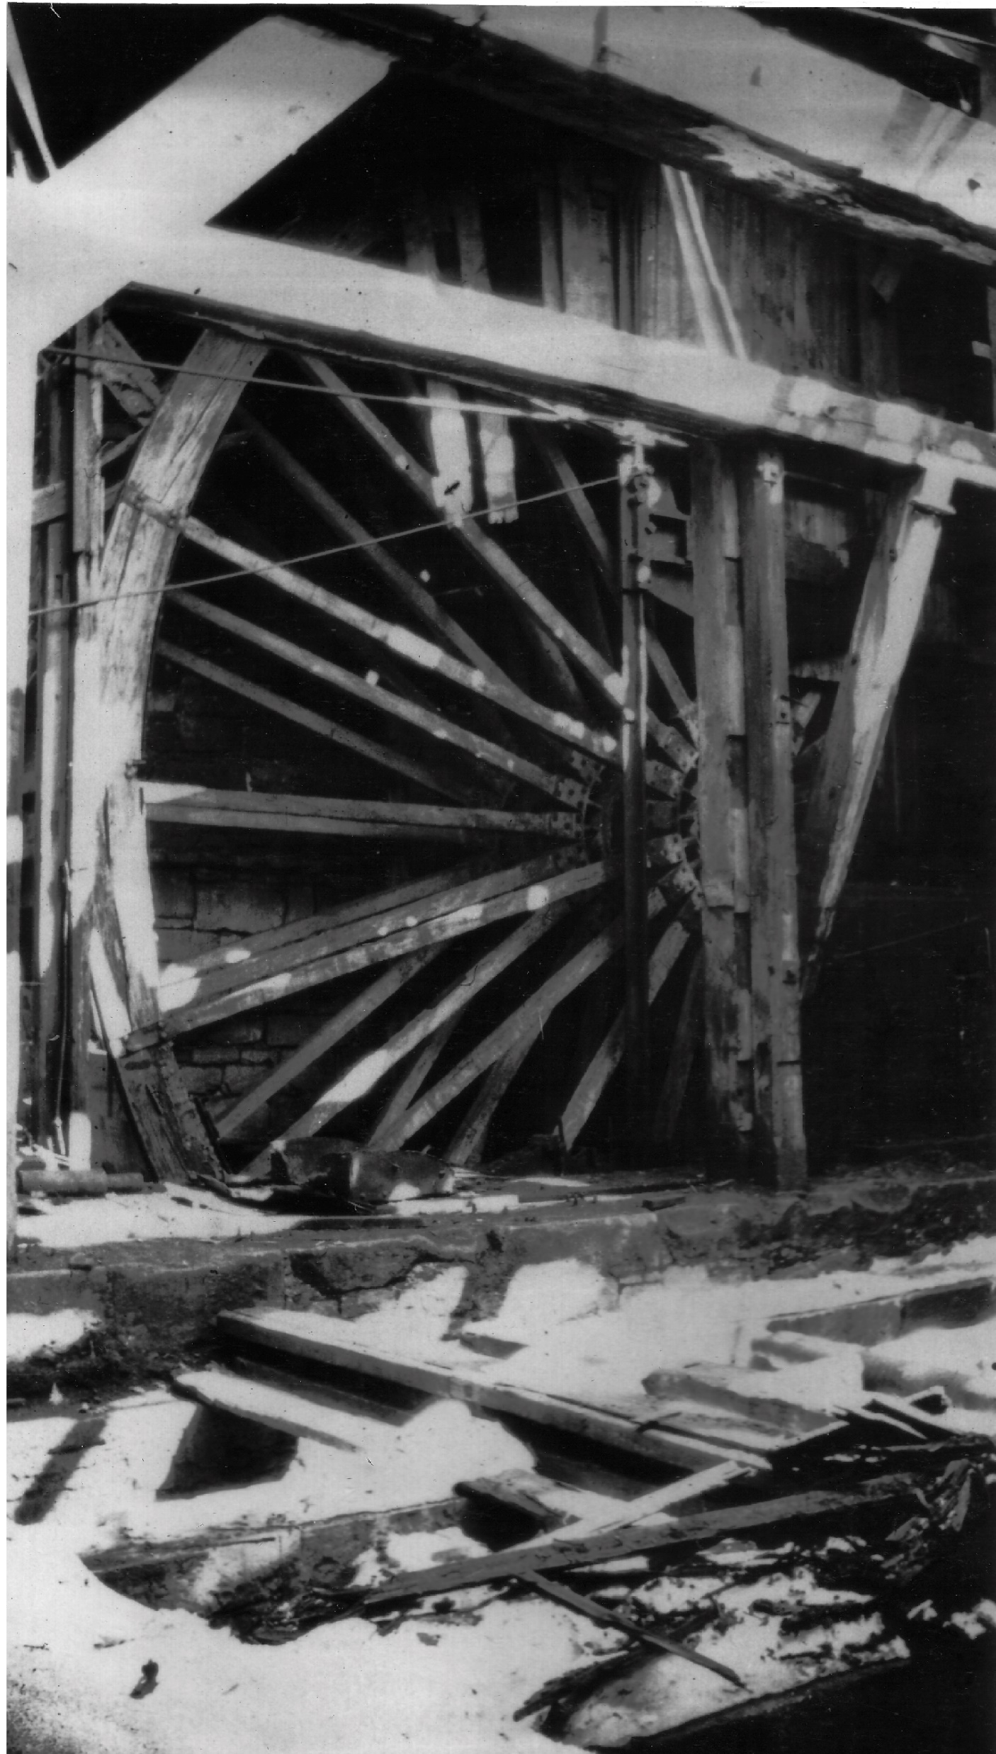
Natural Resources
Industrial production used natural resources both to power machinery and as the raw materials for products.
Water wheels used rivers to generate power. Coal fueled steam engines and furnaces.
Cotton was used in the textile industry and iron ore was smelted to make tools, machines, and weapons.
Natural resources used by the West Point Foundry included trees to make charcoal for their furnaces, and iron ore for smelting.

Slide 4
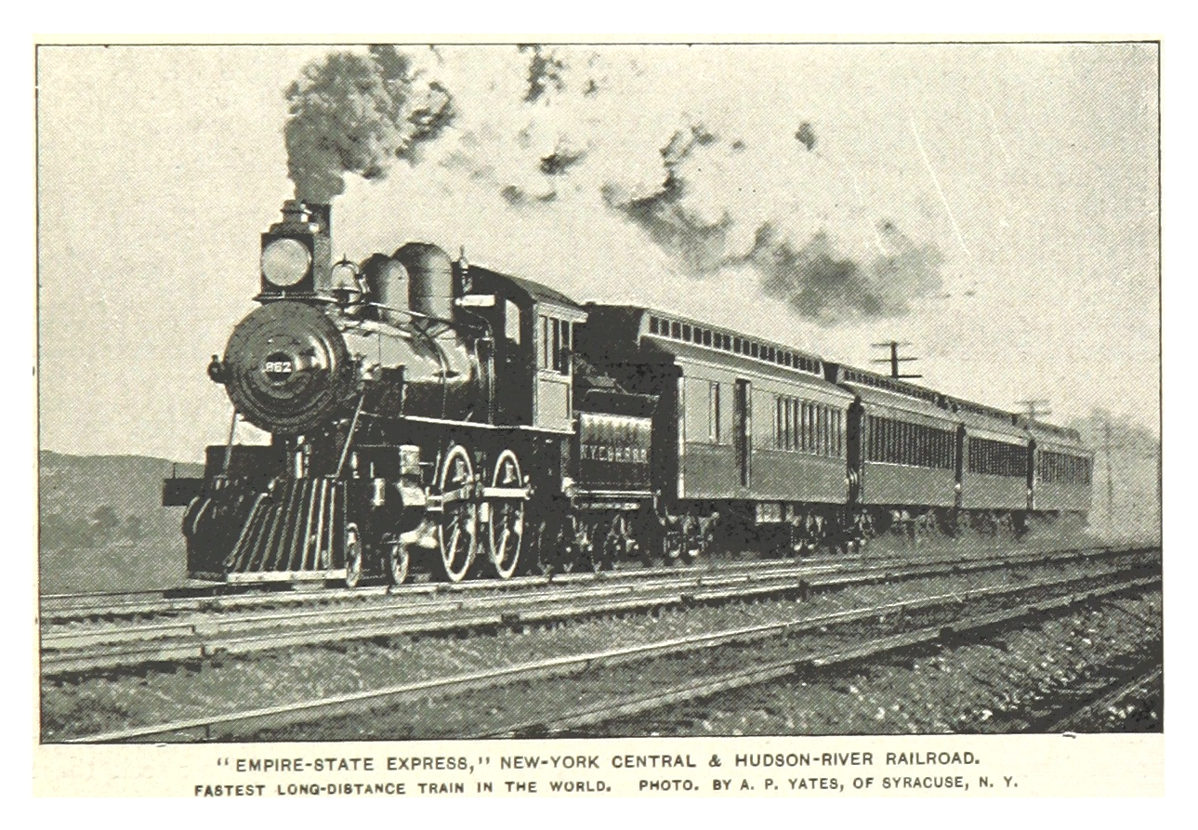
Transportation
Industrialists needed better means of transportation to bring their finished goods to market.
Steamships replaced barges and sailing ships. Canals connected waterways, allowing increased commercial activity.
Railroads were built across the United States during the 19th century, enabling companies to transport good faster.
The West Point Foundry built the first American-made locomotive and produced early steam engines for ships.

Slide 5
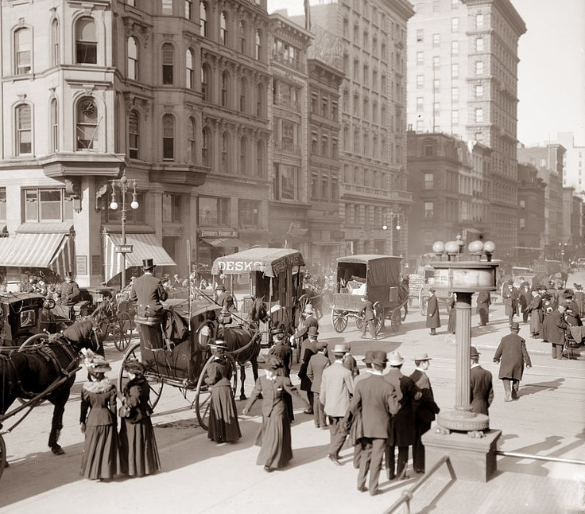
Urbanization
People moved from rural areas into cities to work at factories. This process is called urbanization.
Growing cities were unsanitary and densely populated. The working class were forced to live in cramped tenement buildings.
Journalist Jacob Riis exposed these conditions with photography in his book How the Other Half Lives.
The Foundry’s large workforce caused the population of Cold Spring to grow from several hundred in 1820, to over 3,000 by 1870.

Slide 6
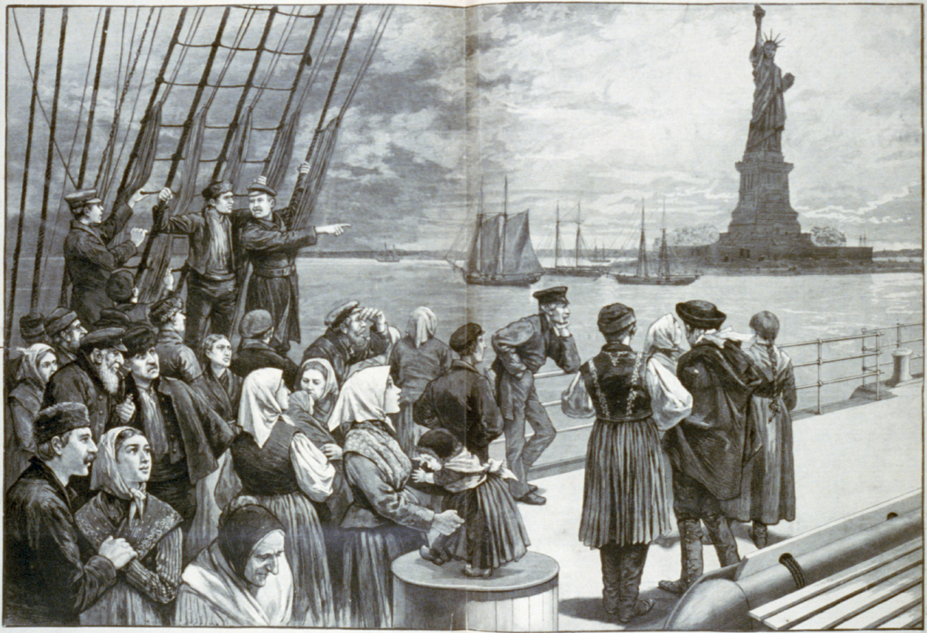
Labor
Immigrants helped fill the United State’s labor needs. From 1820 to 1924, at least 36 million people migrated to the United States.
Child labor was common in the 19th century. Youth worked in mills and factories for low wages.
Long hours and dangerous working conditions led to the growth of labor unions and social reform movements.
The Foundry employed many Irish immigrants. Boys worked at the Foundry as apprentices.

Slide 7
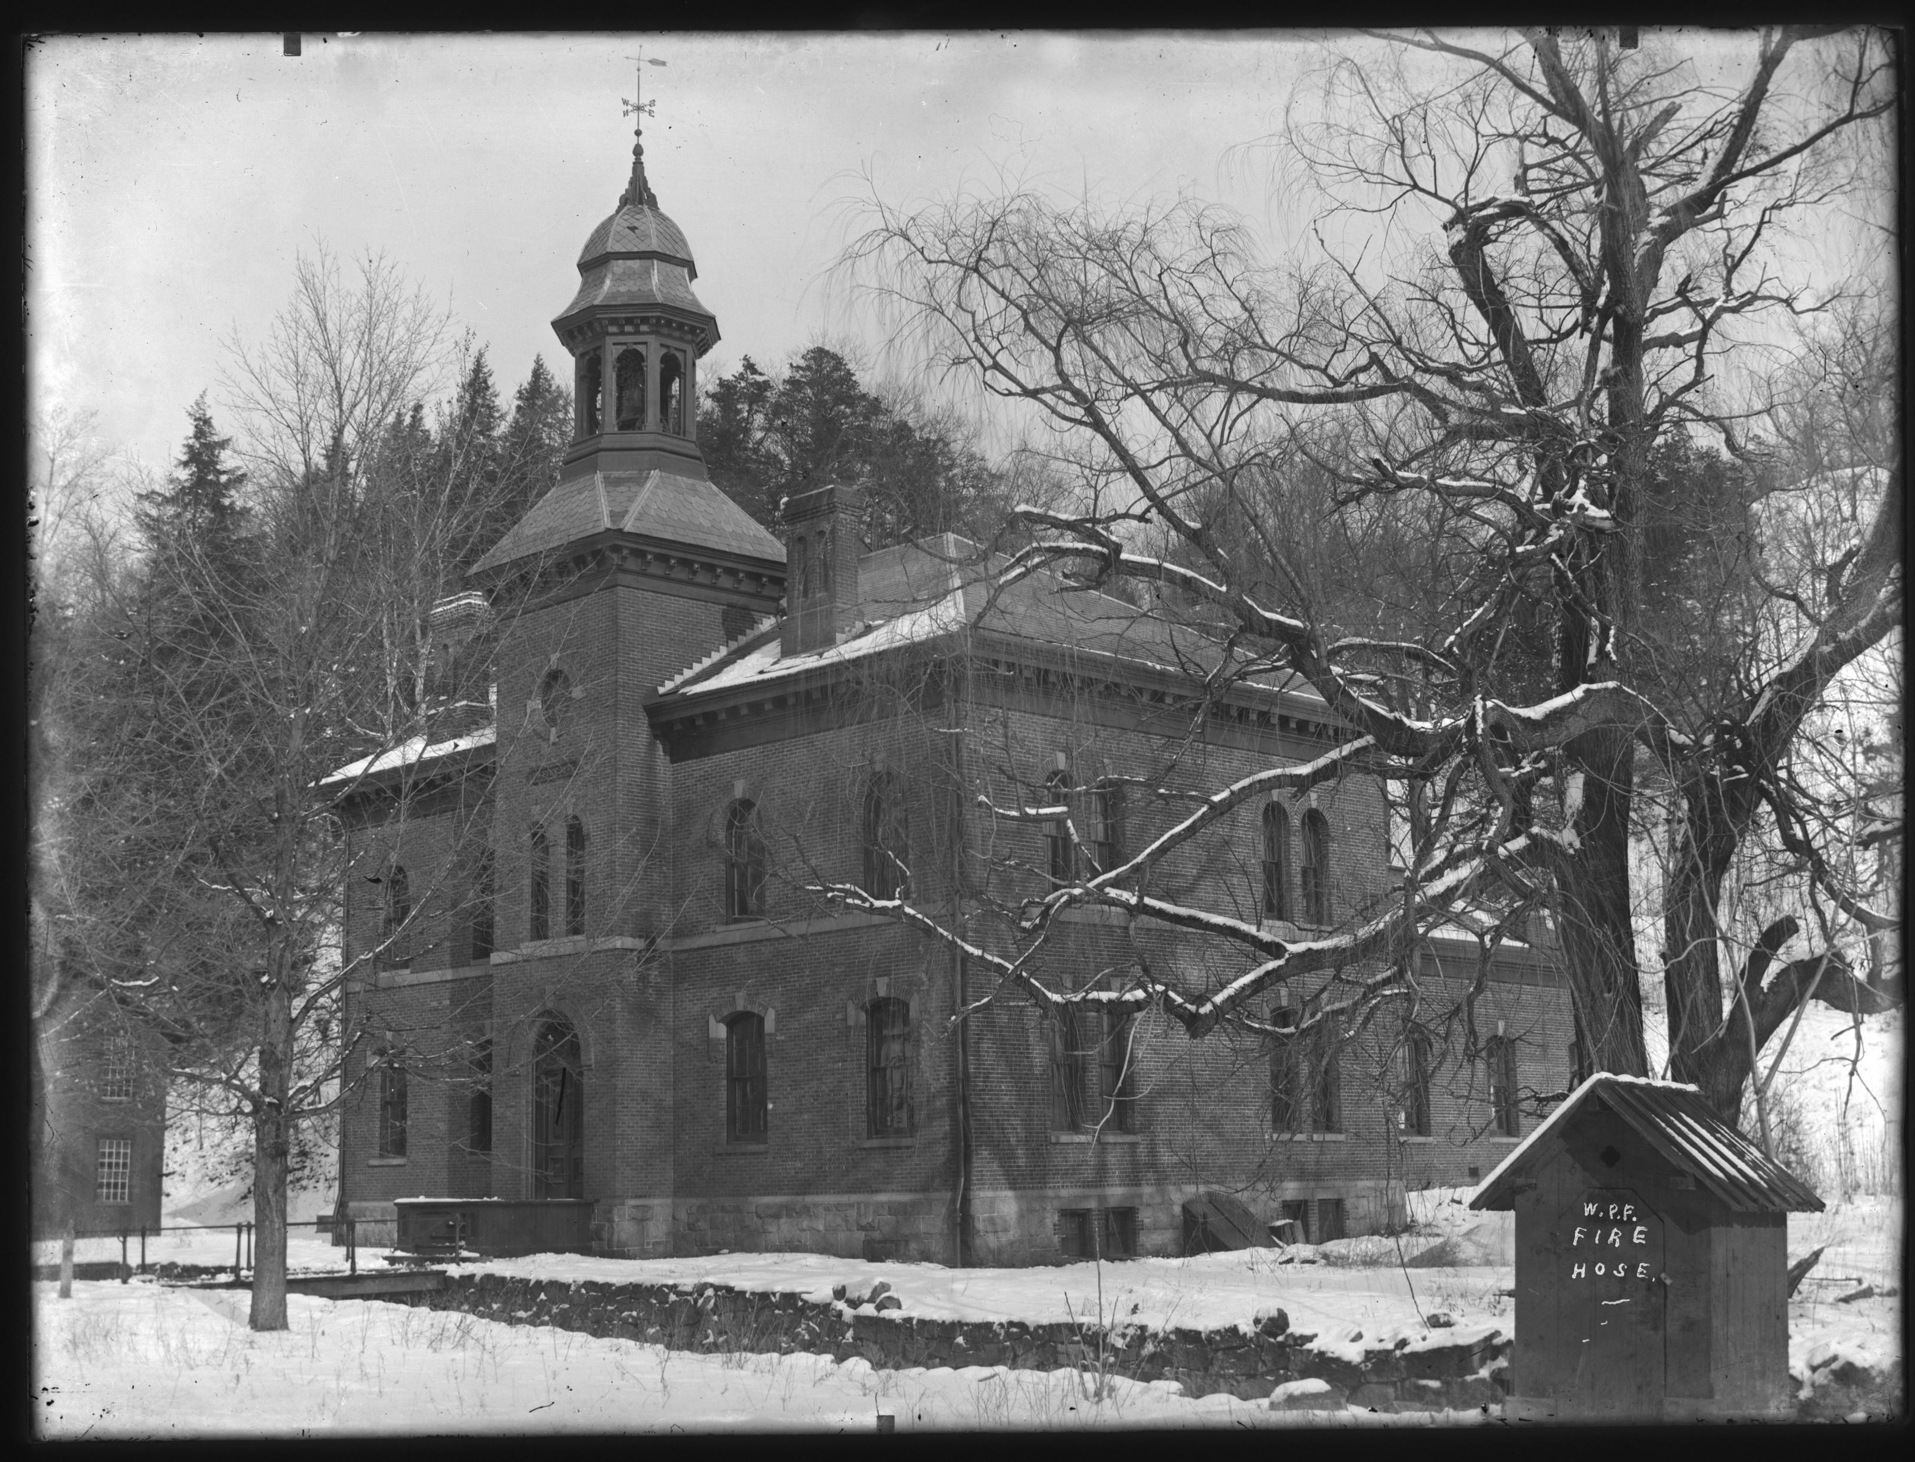
Economics
The owners of industrial companies became incredibly wealthy while their employees in factories often struggled to make a living.
Companies like John D. Rockefeller's Standard Oil gained a monopoly in their field. A monopoly has exclusive control over a good or service.
The West Point Foundry made the modern equivalent of $40 million dollars during the Civil War, but employees went on strike to demand higher wages during this period.

